Slide 1

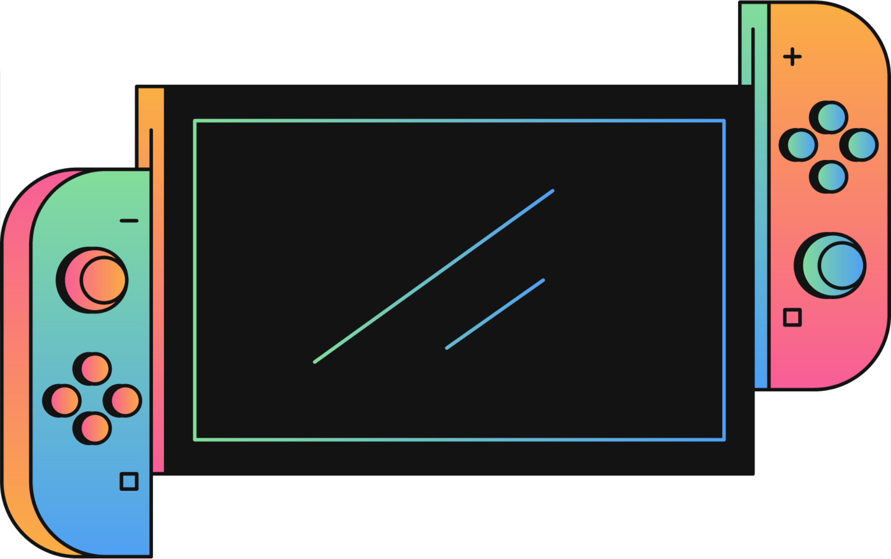
NOOBS POKER
START

Slide 2
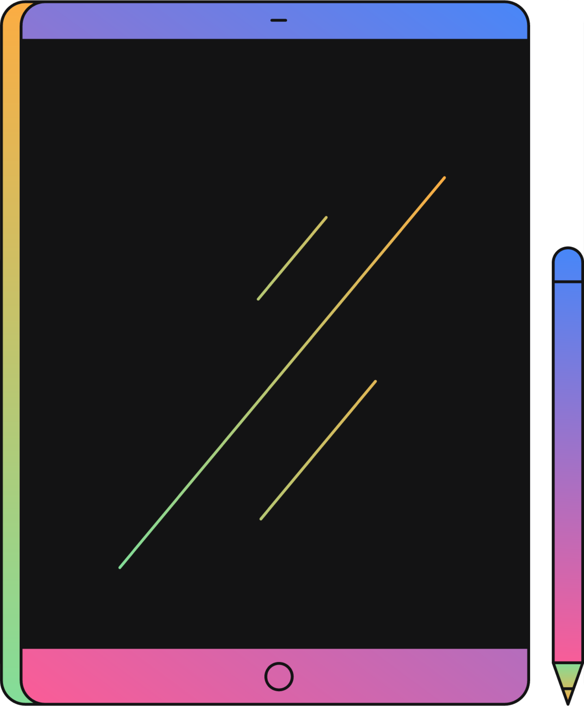
PLAYER1
PLAYER2
PLAYER3
YEAMIN MAHMUD
ASHFAQ HASSAN SHIFAT
DEWAN FATIN HASNAT

Slide 3
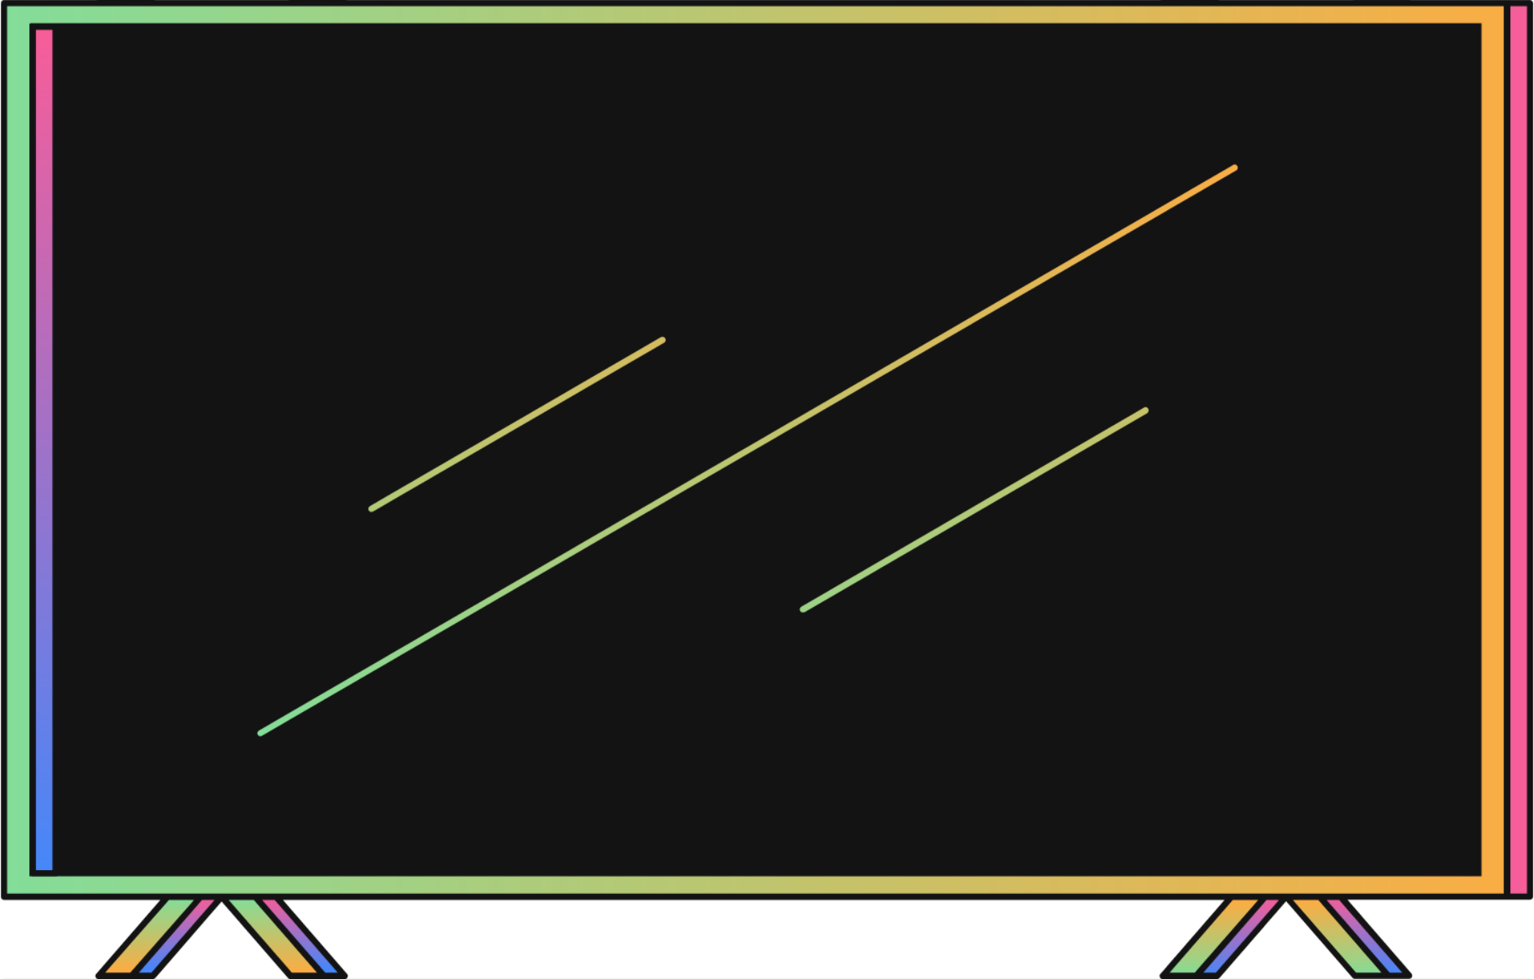
INTRODUCTION TO POKER AND AI
Overview of Poker:
A game of skill, bluffing, and probabilistic outcomes.
Involves incomplete information and decision-making under uncertainty.
Why AI in Poker?
Mimics human decision-making.
Evaluates risks, probabilities, and optimal strategies.

Slide 4
EXPECTIMINIMAX ALGORITHM OVERVIEW
What is Expectiminimax?
Extends the Minimax algorithm for games with randomness.
Handles three nodes: Max (Player decision), Min (Opponent decision), and Chance (Random event like card draws).
How it Works:
Max nodes: Choose the maximum utility move.
Min nodes: Choose the move minimizing the utility.
Chance nodes: Compute expected values based on probabilities of outcomes.

Slide 5
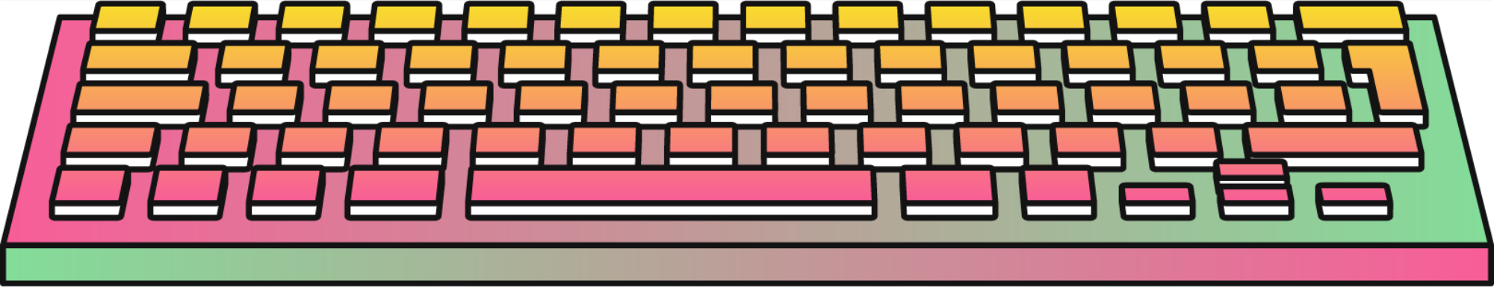
INSTRUCTION
IMPLEMENTATION DETAILS
LANGUAGE:PYTHON
OPERATOR
RANDOM
PYGAME
OS
SYS

Slide 6
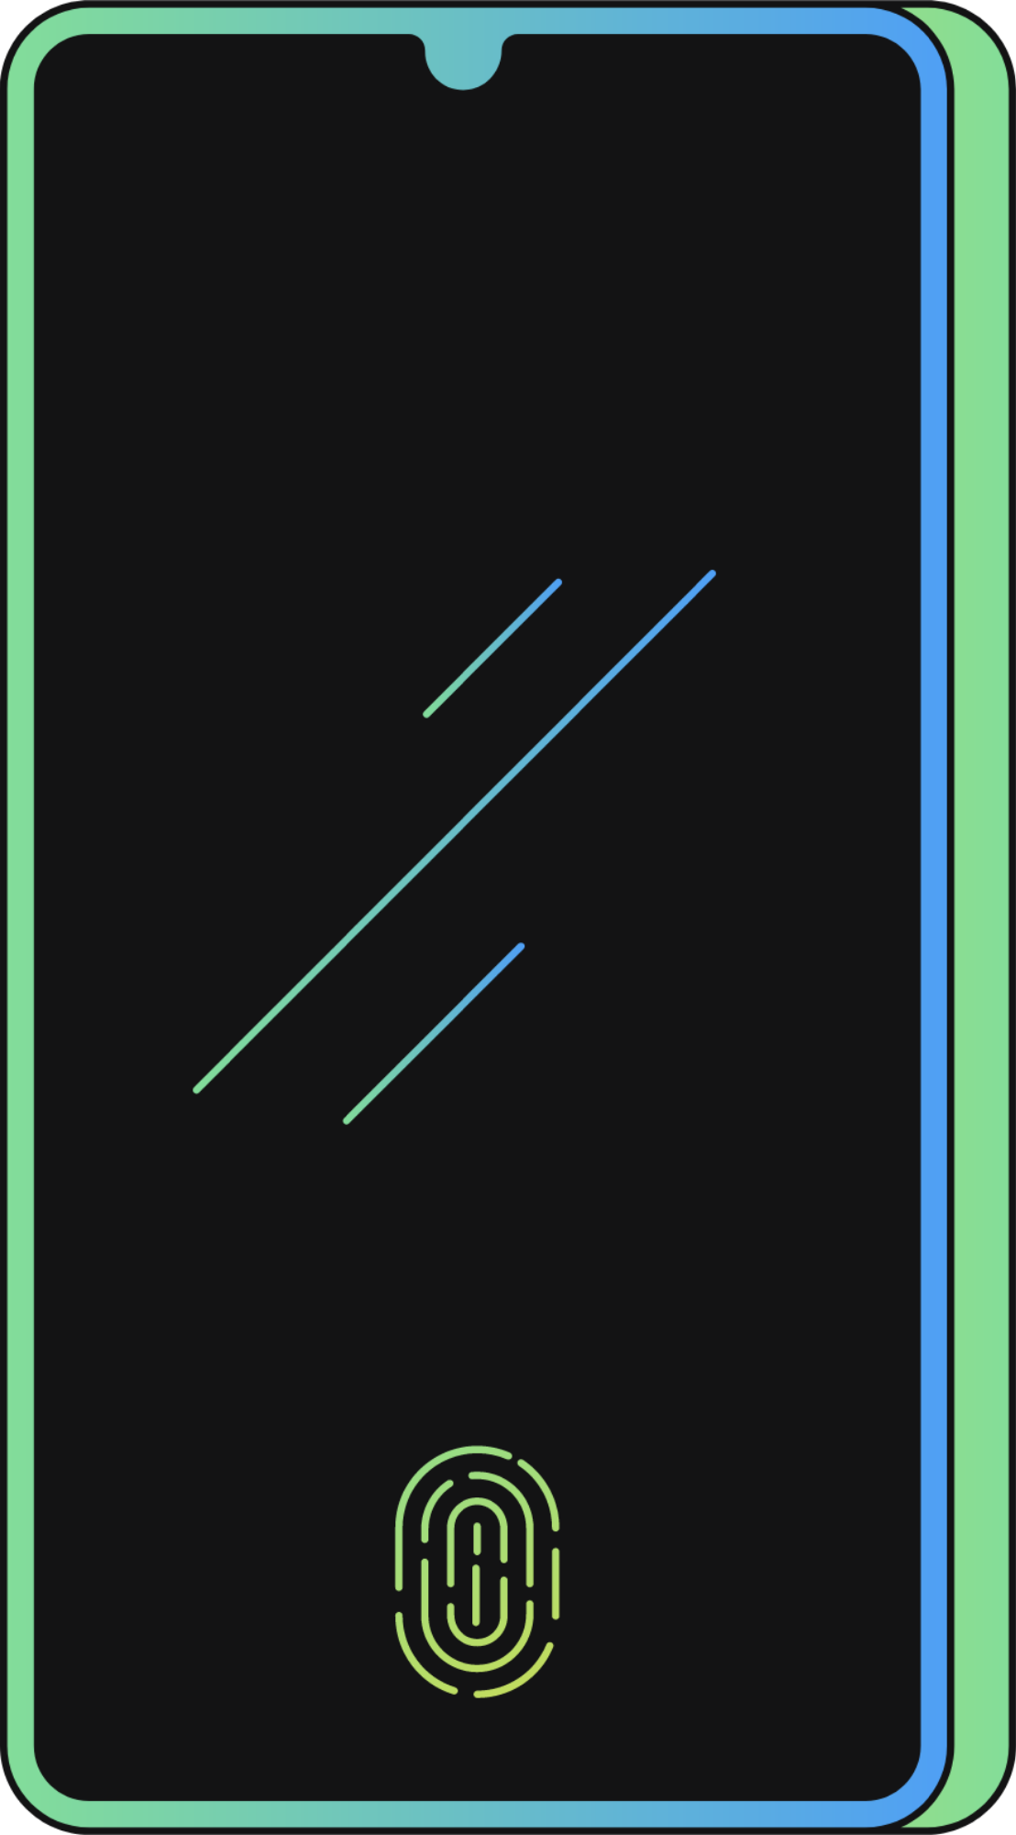
ARE YOU READY?
PLAY

Slide 7
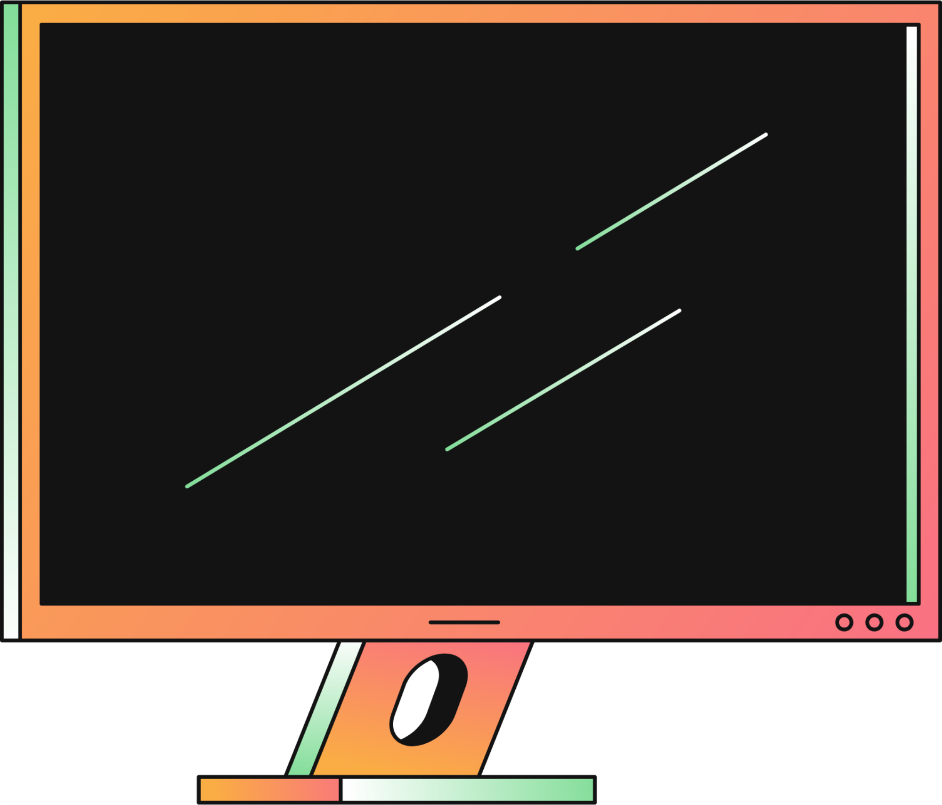
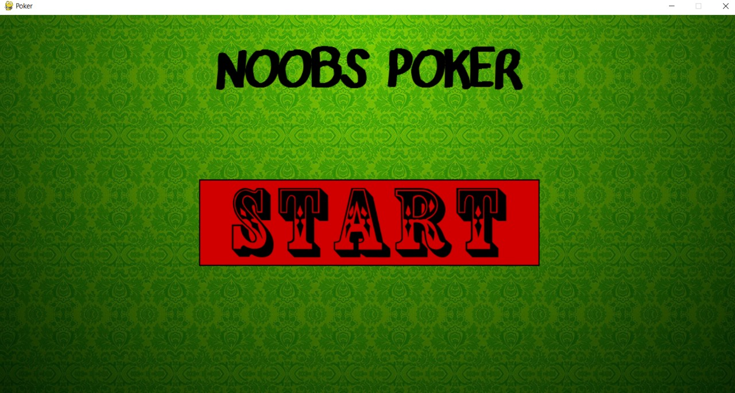

Slide 8
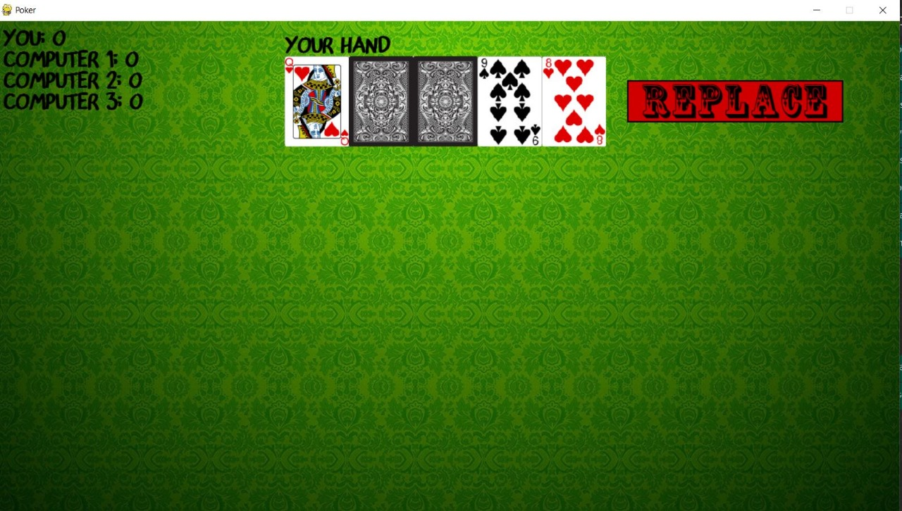

Slide 9
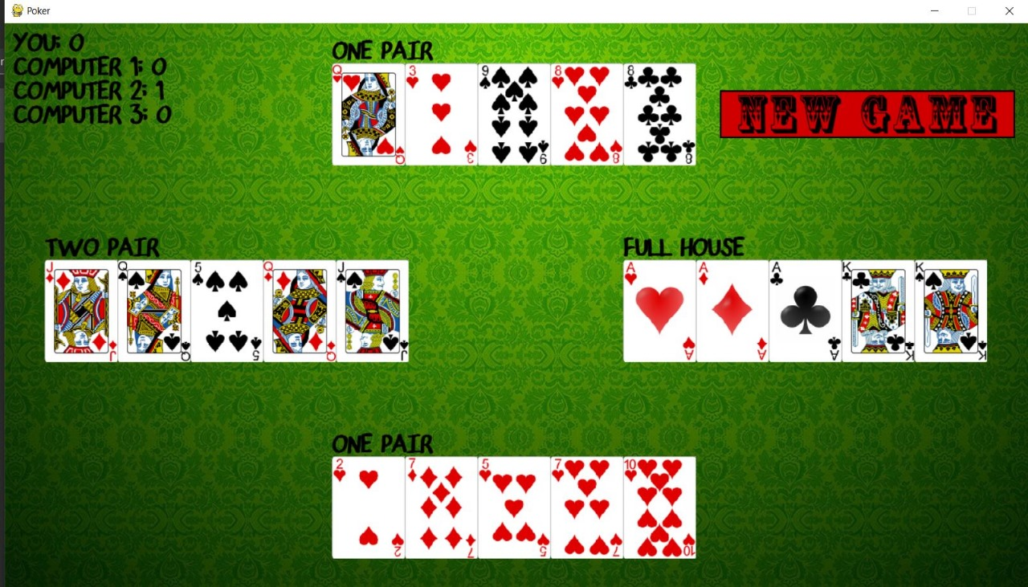

Slide 10
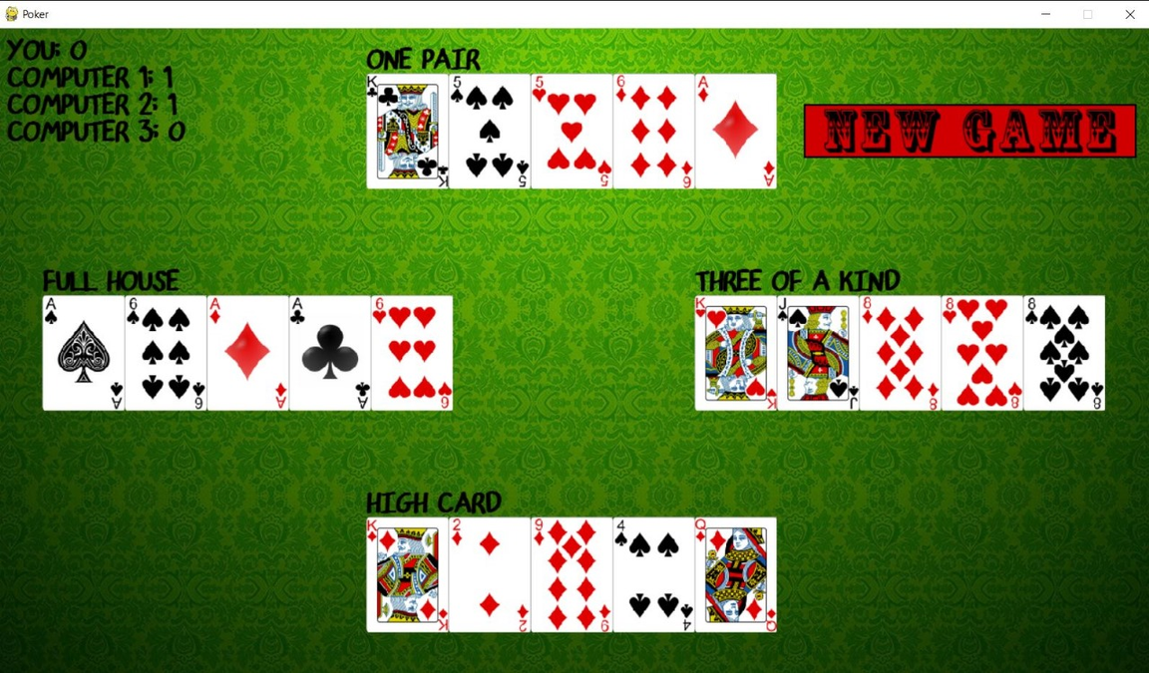

Slide 11
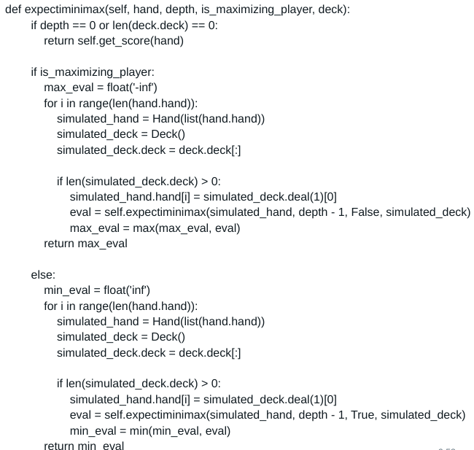
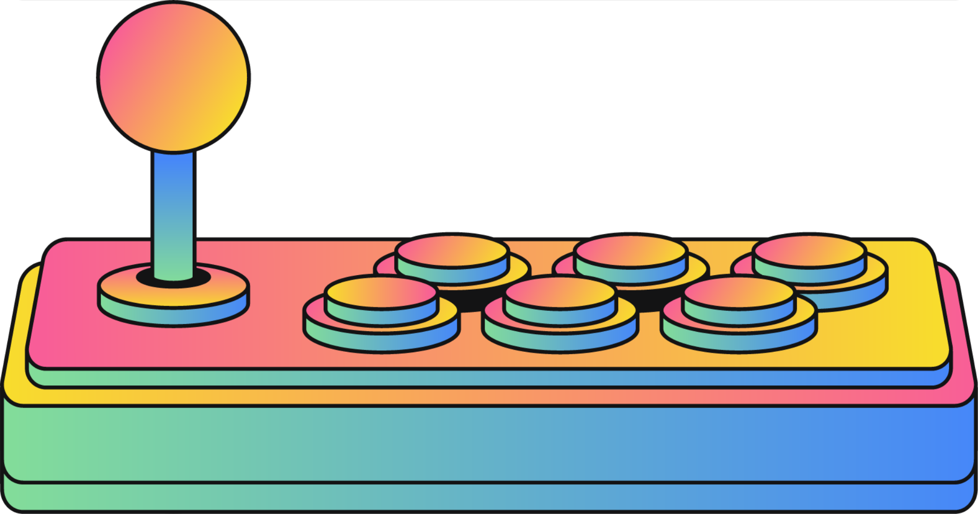
INSTRUCTION
IMPLEMENTATION

Slide 12
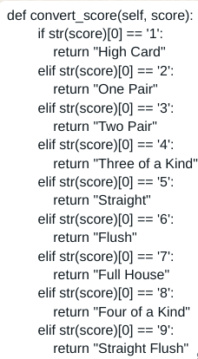
INSTRUCTION
IMPLEMENTATION

Slide 13
INSTRUCTION
CHALLENGES AND FUTURE WORK
Challenges:
High computation time for deep Expectiminimax trees.
Difficulty modeling complex human strategies.
Future Improvements:
Use of heuristic evaluations to reduce tree depth.
Integration with Reinforcement Learning for adaptive strategies.

Slide 14

INSTRUCTION
CONCLUSION
A Poker Game Simulator serves as an engaging and versatile platform for exploring strategic decision-making, probability, and artificial intelligence in gaming. By simulating various aspects of Poker, the simulator replicates the challenges of the game, such as managing incomplete information, anticipating opponents' actions, and handling randomness.

Slide 15
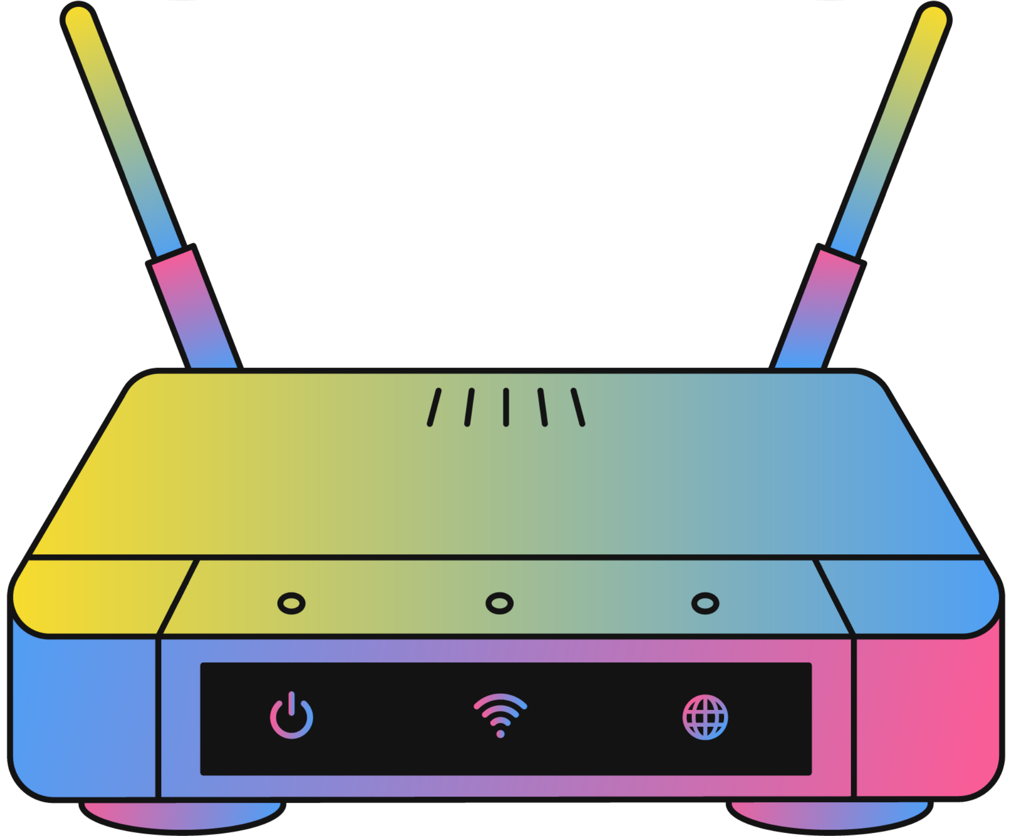
INSTRUCTION
WINNER
ANY QUESTION?
SCORE: 9/10

Slide 16
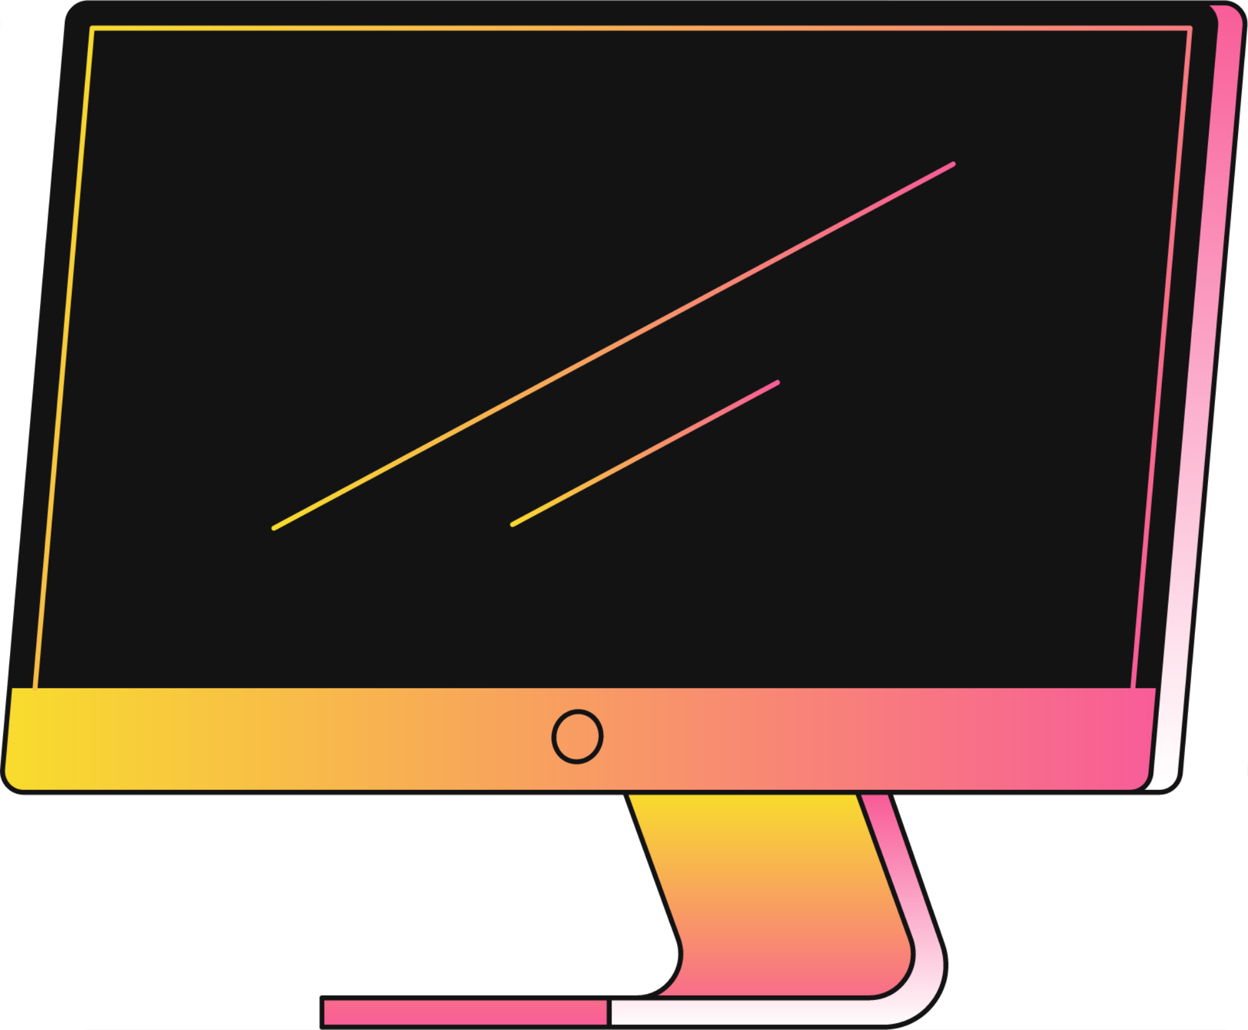
THANKS FOR PLAYING!
END

